Slide 1
Lab. No. 9
Supportive connective tissues
( Bones and Cartilages )
م.م. ندى صالح هادي

Slide 2
Bones : are the rigid organs that constitutes part of the vertebrate skeletal system , bone tissue is the structural component of bones .
Bone tissue is classified to :
Compact bone
Spongy bone
Bone cells :
Osteoblast
Bone lining cells
Osteocyte
Osteoclast

Slide 3
Compact bone forms the hard external layer of all bones and surrounds the bone marrow. It also makes up about 80% of the bone in a human skeleton. It is smooth, hard and heavy compared to spongy bone and it is also white in appearance, in contrast to spongy bone which has a pink color. Compact bone is made up of units called lamellae which are sheets of collagen aligned in a parallel pattern that gives the bone strength. Blood vessels supply compact bone with oxygen and nutrients through structures called Haversian canals
spongy bone forms the inner layer of all bones. It also makes up about 20% of a human skeleton. Spongy bone is home to the bone marrow and hematopoietic stem cells that differentiate into red blood cells, white blood cells and platelets. Spongy bone tissue does not contain Haversian systems that constitute compact bone tissue.

Slide 4
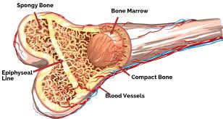

Slide 5
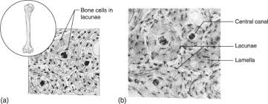

Slide 6
This figure showing a portion of a bony matrix (B). Polarized osteoblasts (Ob) and giant multinucleated osteoclasts (Oc) osteocyte (Ot) surrounding bone matrix

Slide 7
Functions of the bones
locomotion, support and protection of soft tissues
calcium and phosphate storage
Movement due to attached skeletal muscle
Blood cell formation

Slide 8
Cartilage is a smooth elastic tissue, a rubber-like padding that covers and protects the ends of long bones at the joints. It is not hard and rigid as bone, but it is much stiffer and much less flexible than muscle.
Type of cartilage
Hyaline cartilage
Elastic cartilage
Fibro cartilage

Slide 9
